Slide 1


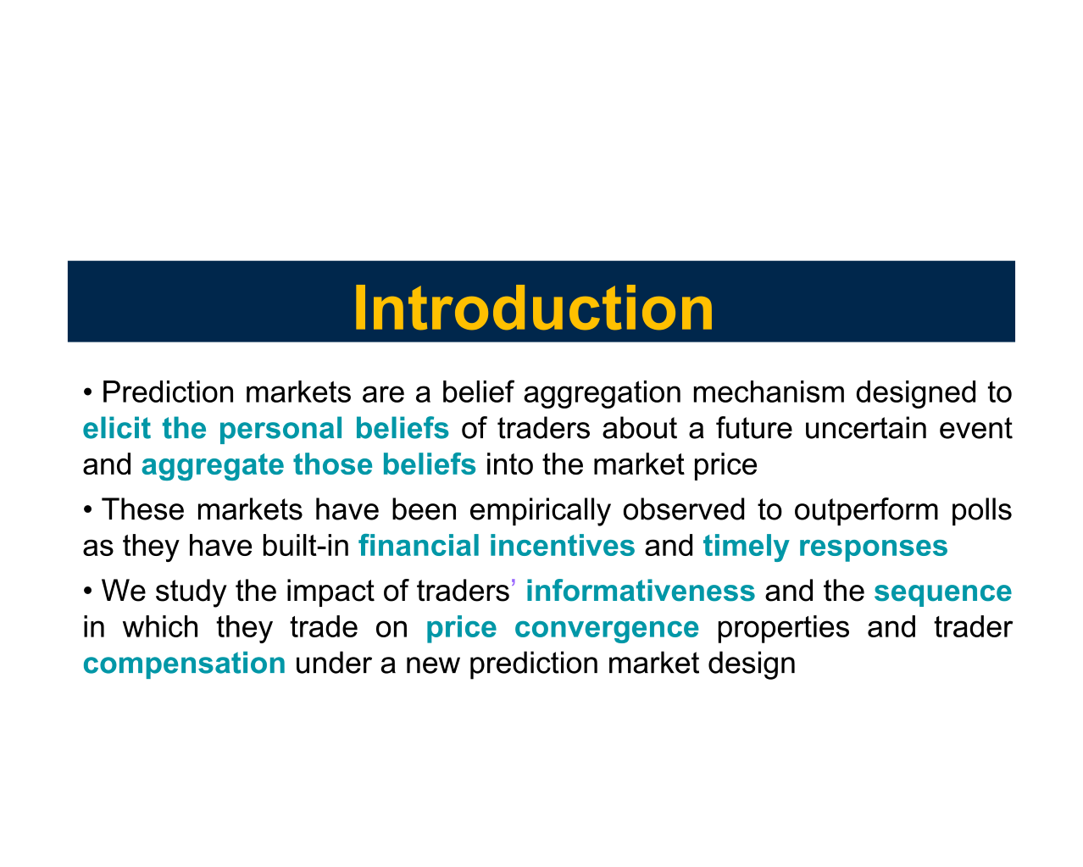
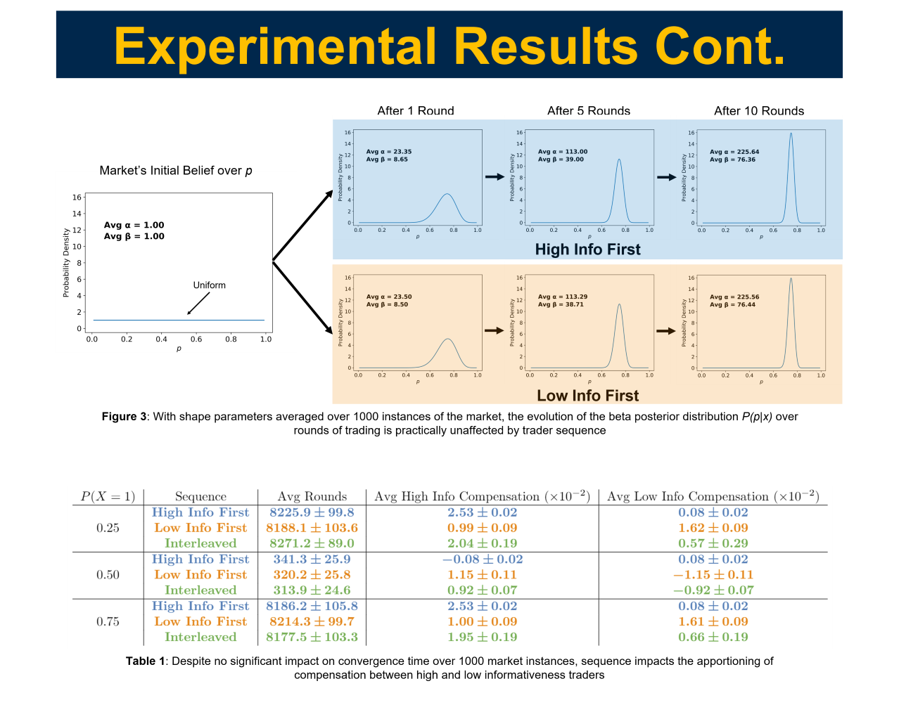
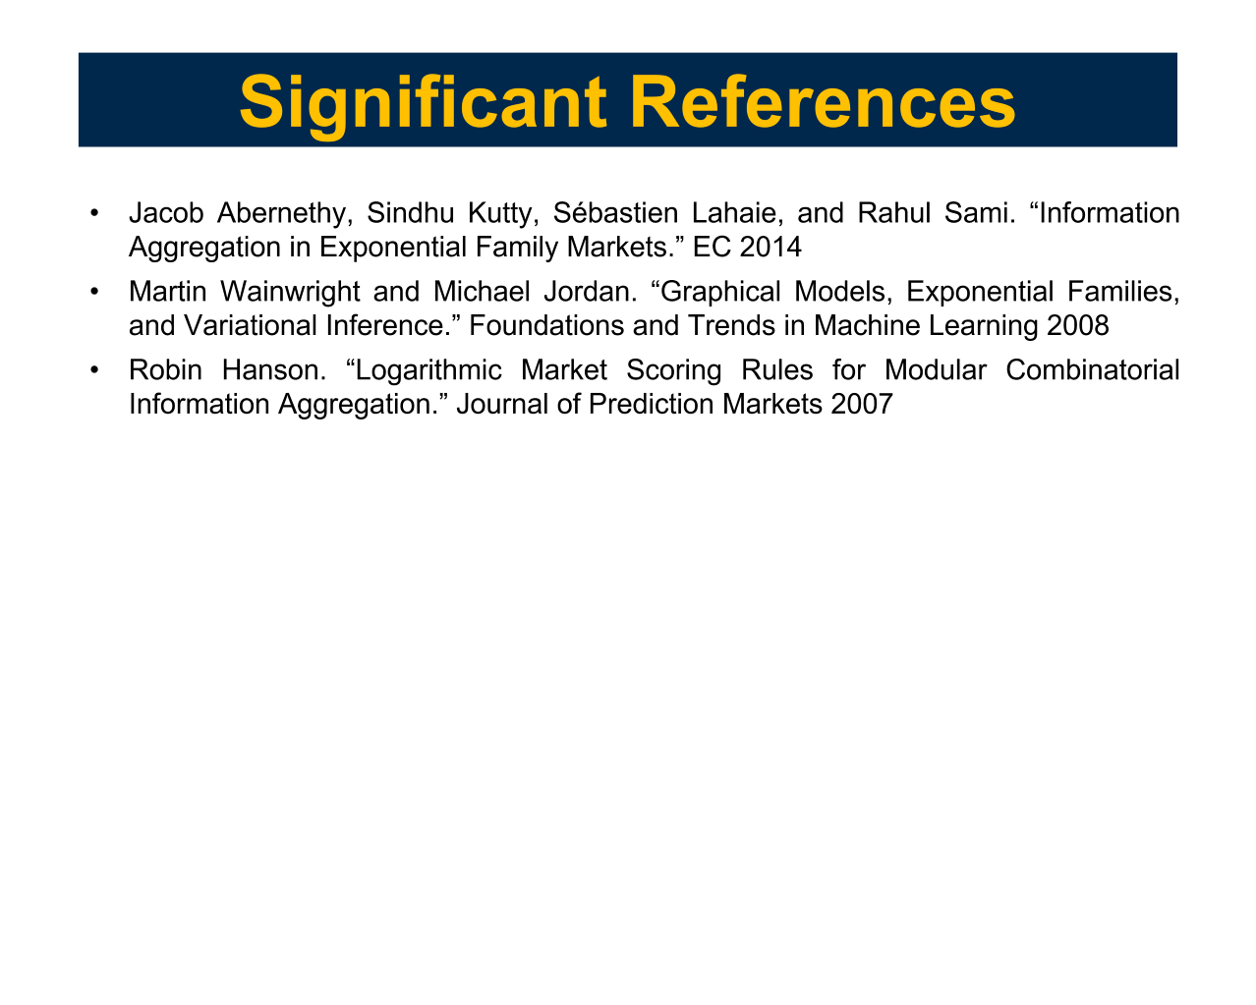

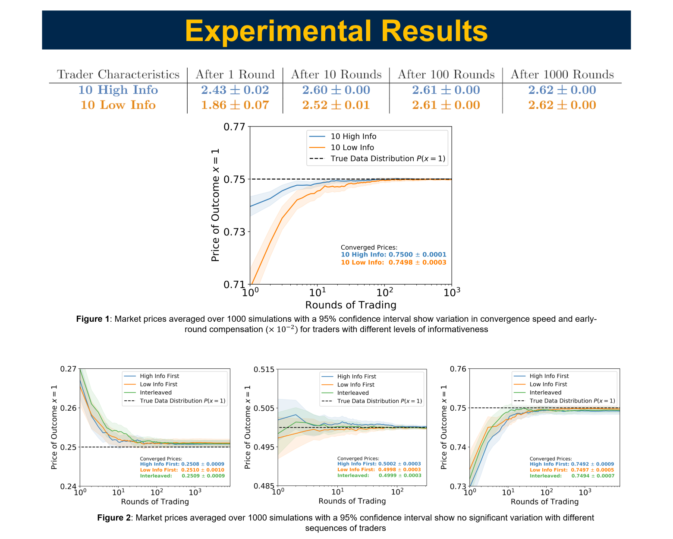
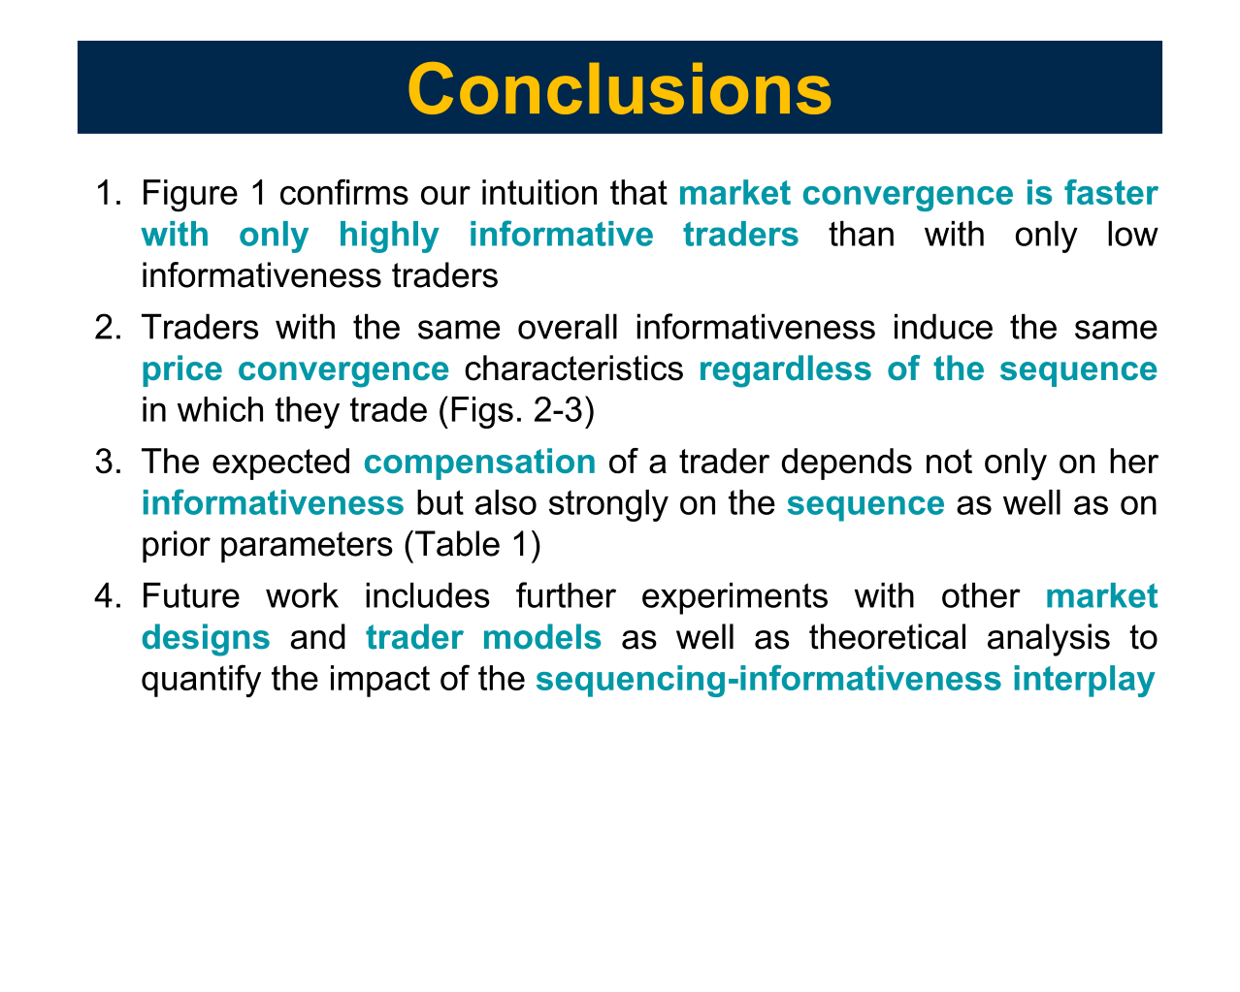
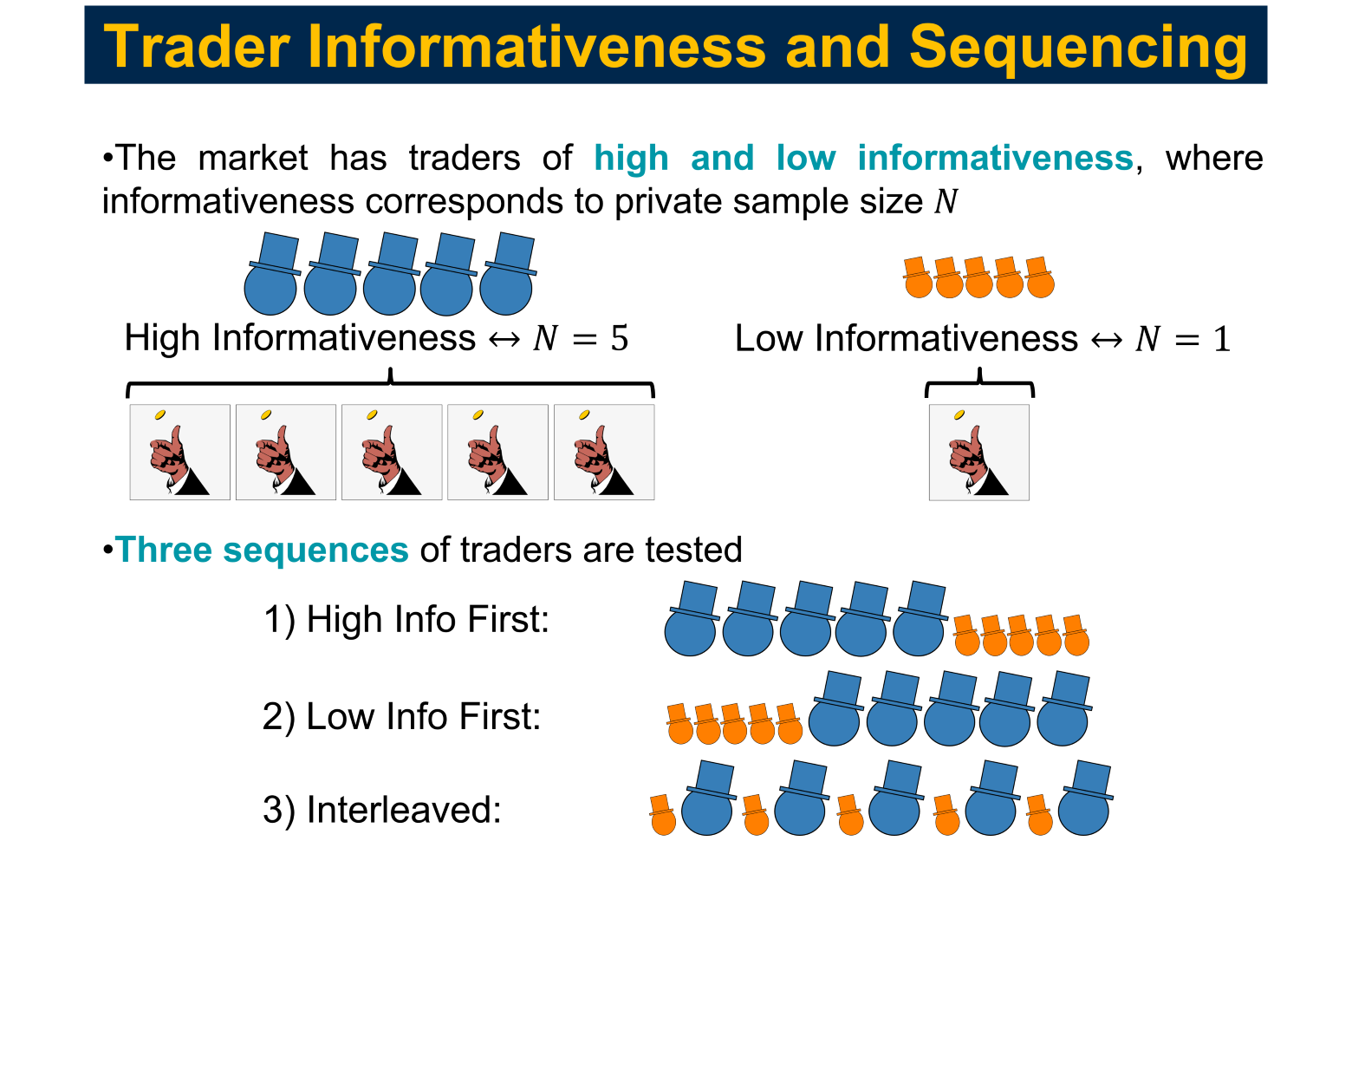
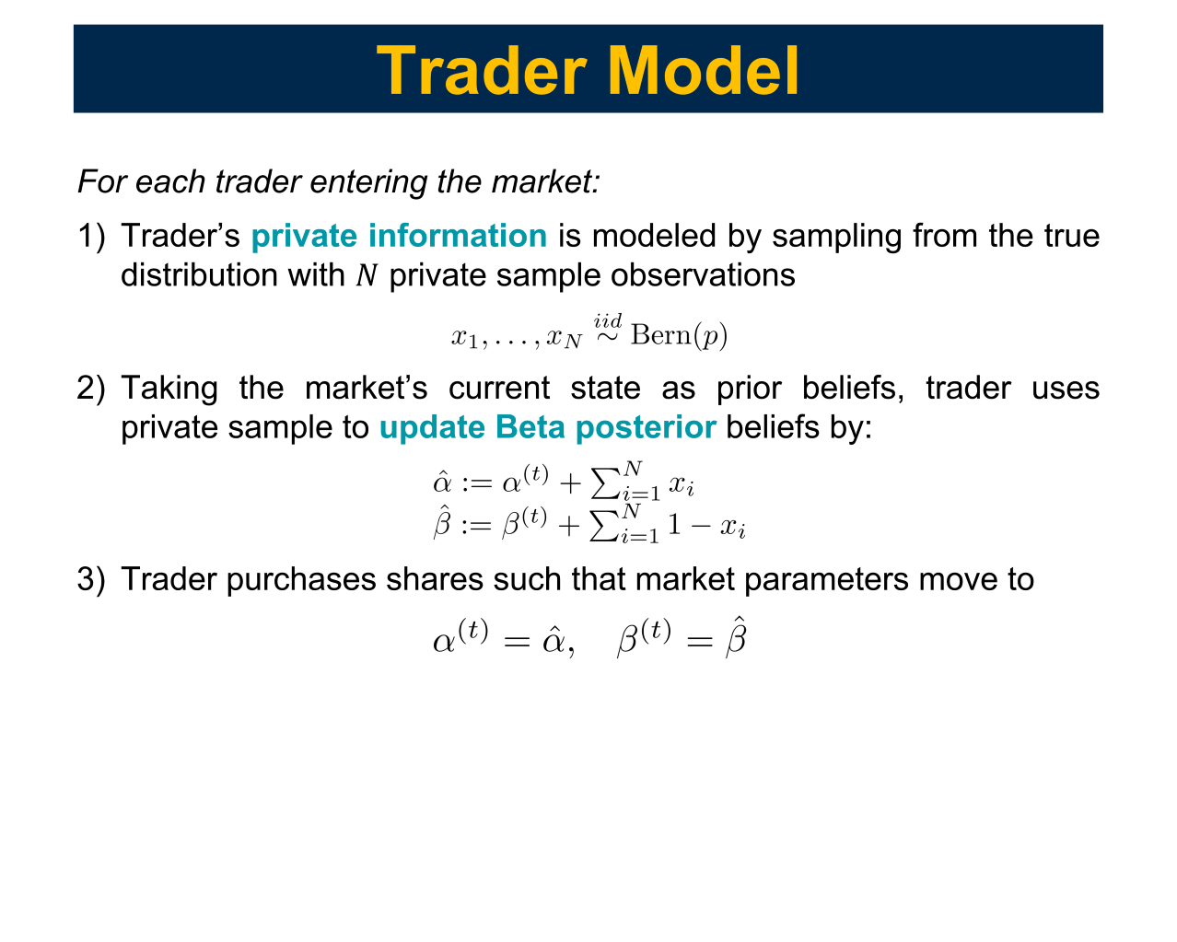
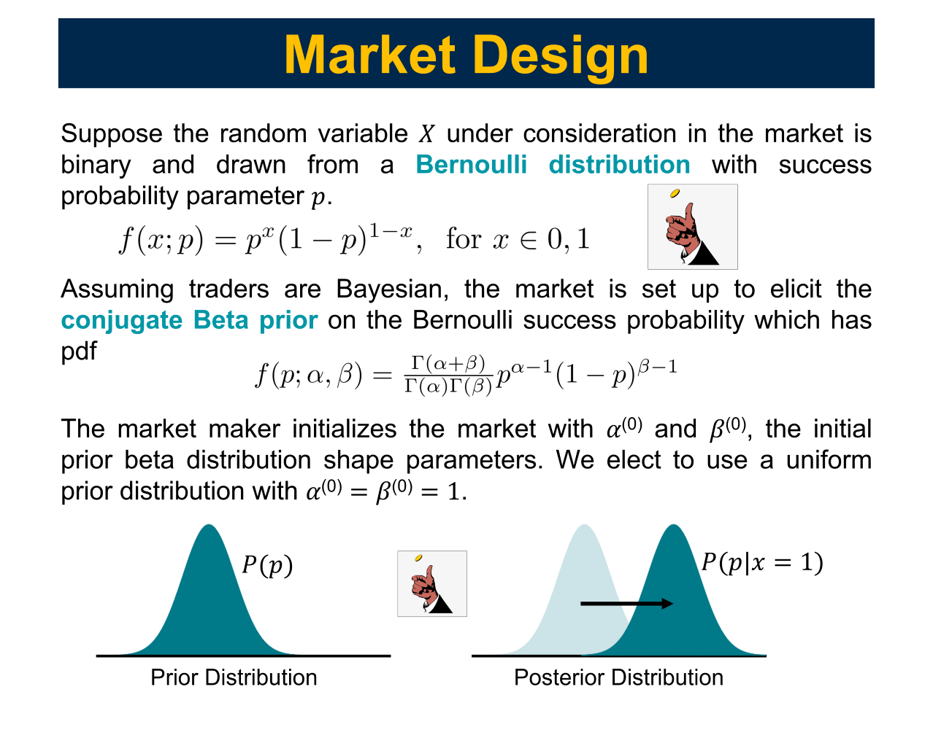

What I Know and When I Say It
How Trading Order and Informativeness Affect Market Prices
Blake Martin, Mithun Chakraborty, Sindhu Kutty
Department of Electrical Engineering and Computer Science, University of Michigan, Ann Arbor, MI

Slide 2
Introduction
Prediction markets are a belief aggregation mechanism designed to elicit the personal beliefs of traders about a future uncertain event and aggregate those beliefs into the market price
These markets have been empirically observed to outperform polls as they have built-in financial incentives and timely responses
We study the impact of traders’ informativeness and the sequence in which they trade on price convergence properties and trader compensation under a new prediction market design

Slide 3

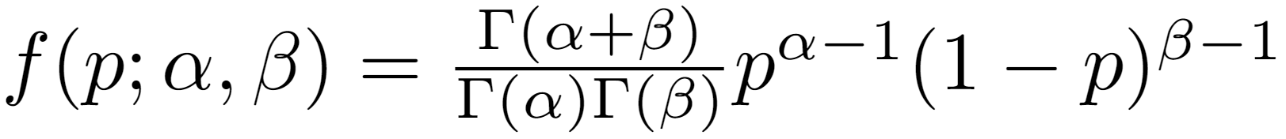
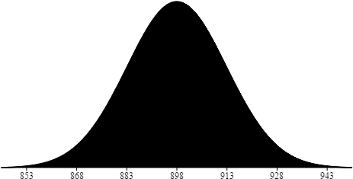
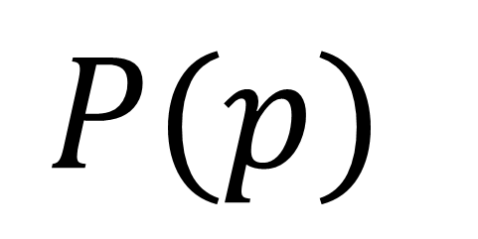
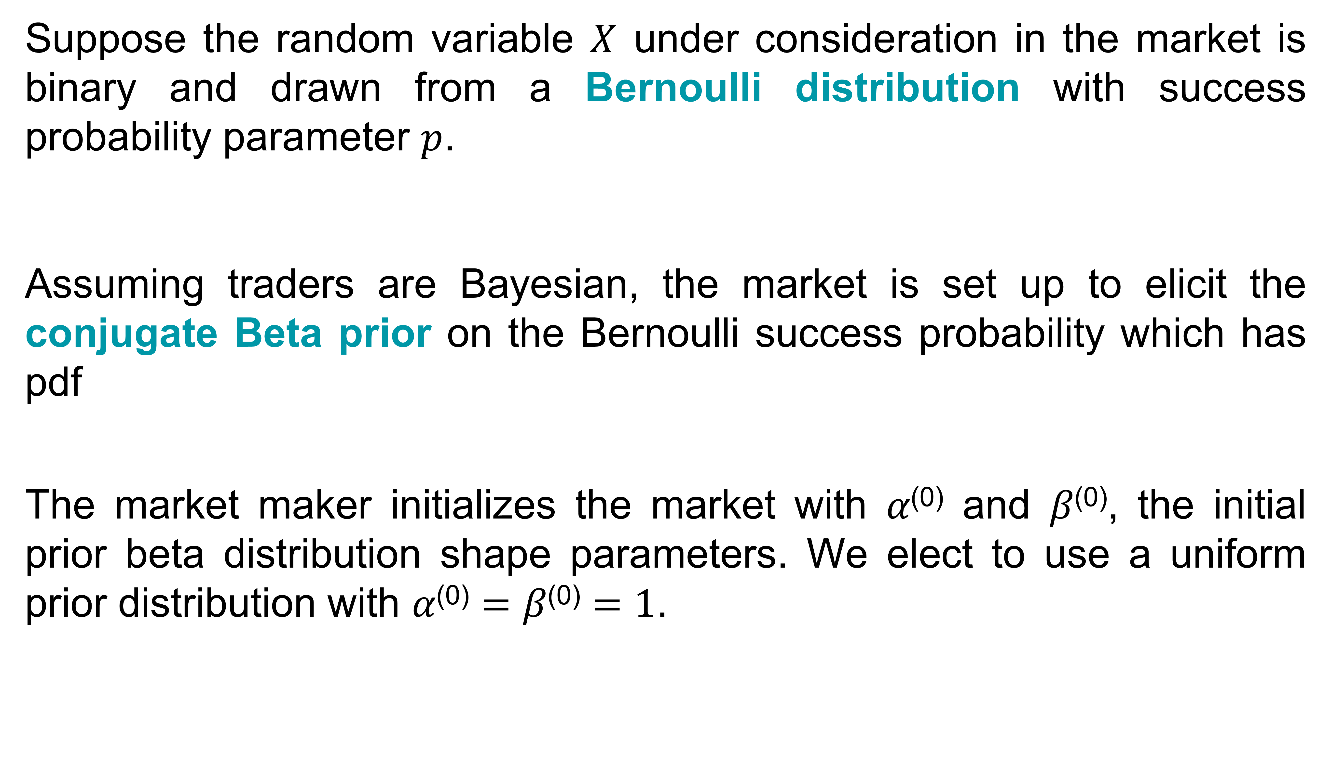
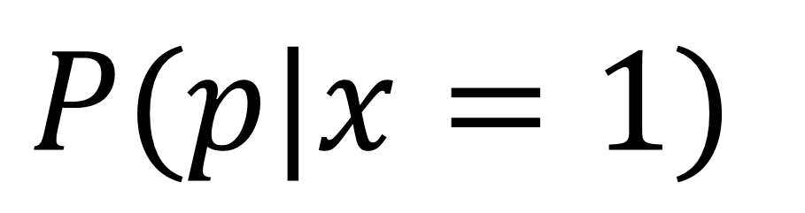
Market Design
Suppose the random variable $X$ under consideration in the market is binary and drawn from a Bernoulli distribution with success probability parameter $p$.
Assuming traders are Bayesian, the market is set up to elicit the conjugate Beta prior on the Bernoulli success probability which has pdf
The market maker initializes the market with 𝛼⁽⁰⁾ and 𝛽⁽⁰⁾, the initial prior beta distribution shape parameters. We elect to use a uniform prior distribution with 𝛼⁽⁰⁾ $=$ 𝛽⁽⁰⁾ $=1$.
$$P(p)$$
$$P(p|x=1)$$
Prior Distribution
Posterior Distribution

Slide 4
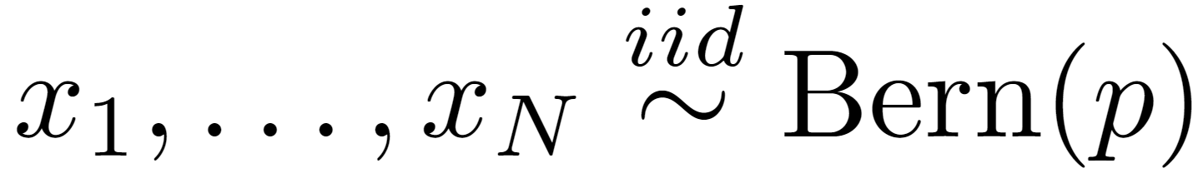
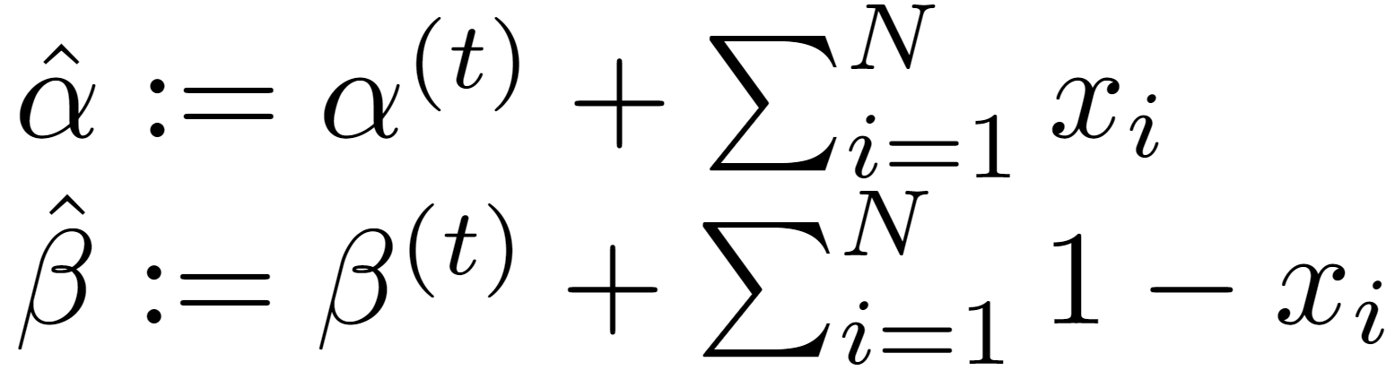
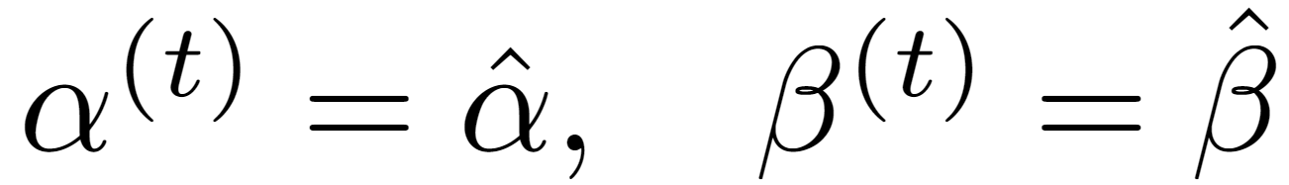
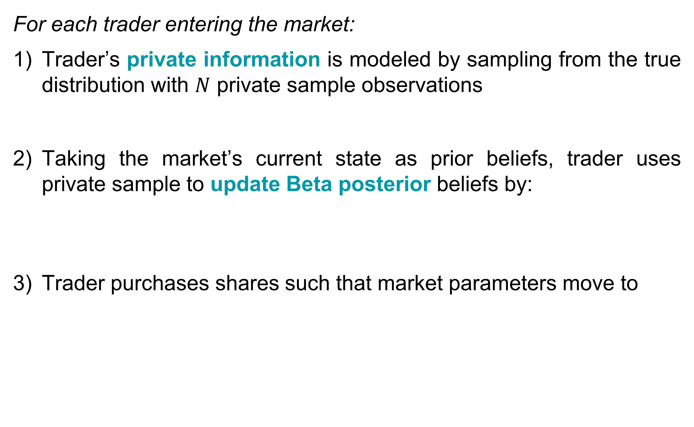
Trader Model
For each trader entering the market:
Trader’s private information is modeled by sampling from the true distribution with $N$ private sample observations
Taking the market’s current state as prior beliefs, trader uses private sample to update Beta posterior beliefs by:
Trader purchases shares such that market parameters move to

Slide 5
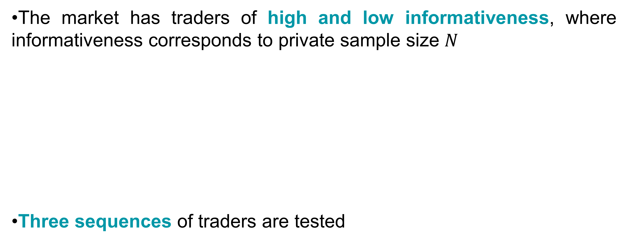
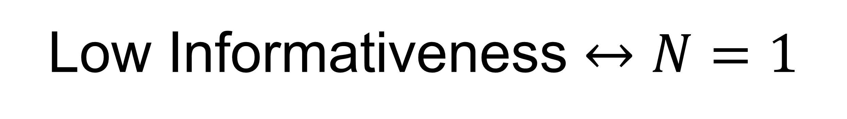
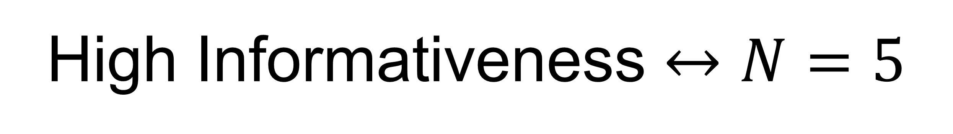
Trader Informativeness and Sequencing
The market has traders of high and low informativeness, where informativeness corresponds to private sample size $N$
Three sequences of traders are tested
High Informativeness $↔N=5$
Low Informativeness $↔N=1$
1) High Info First:
2) Low Info First:
3) Interleaved:

Slide 6
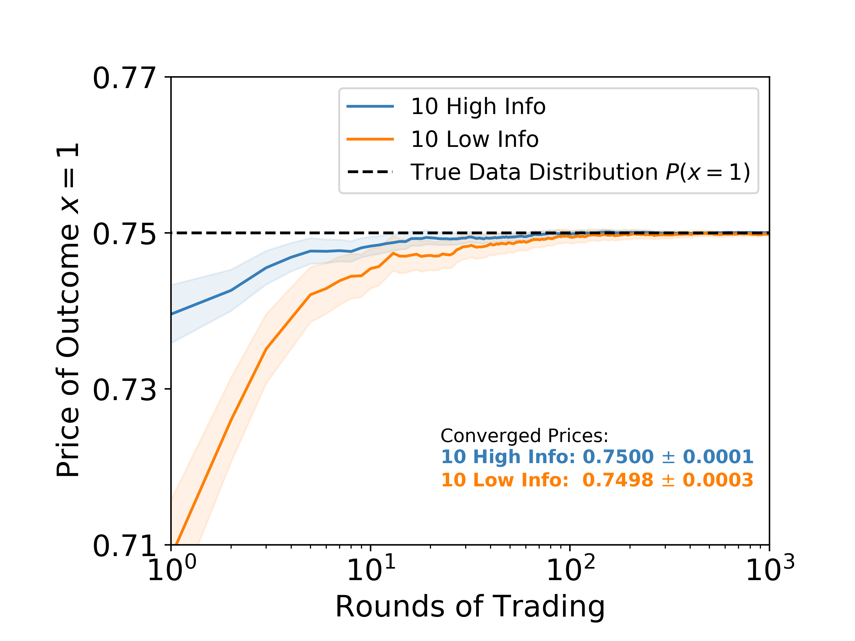
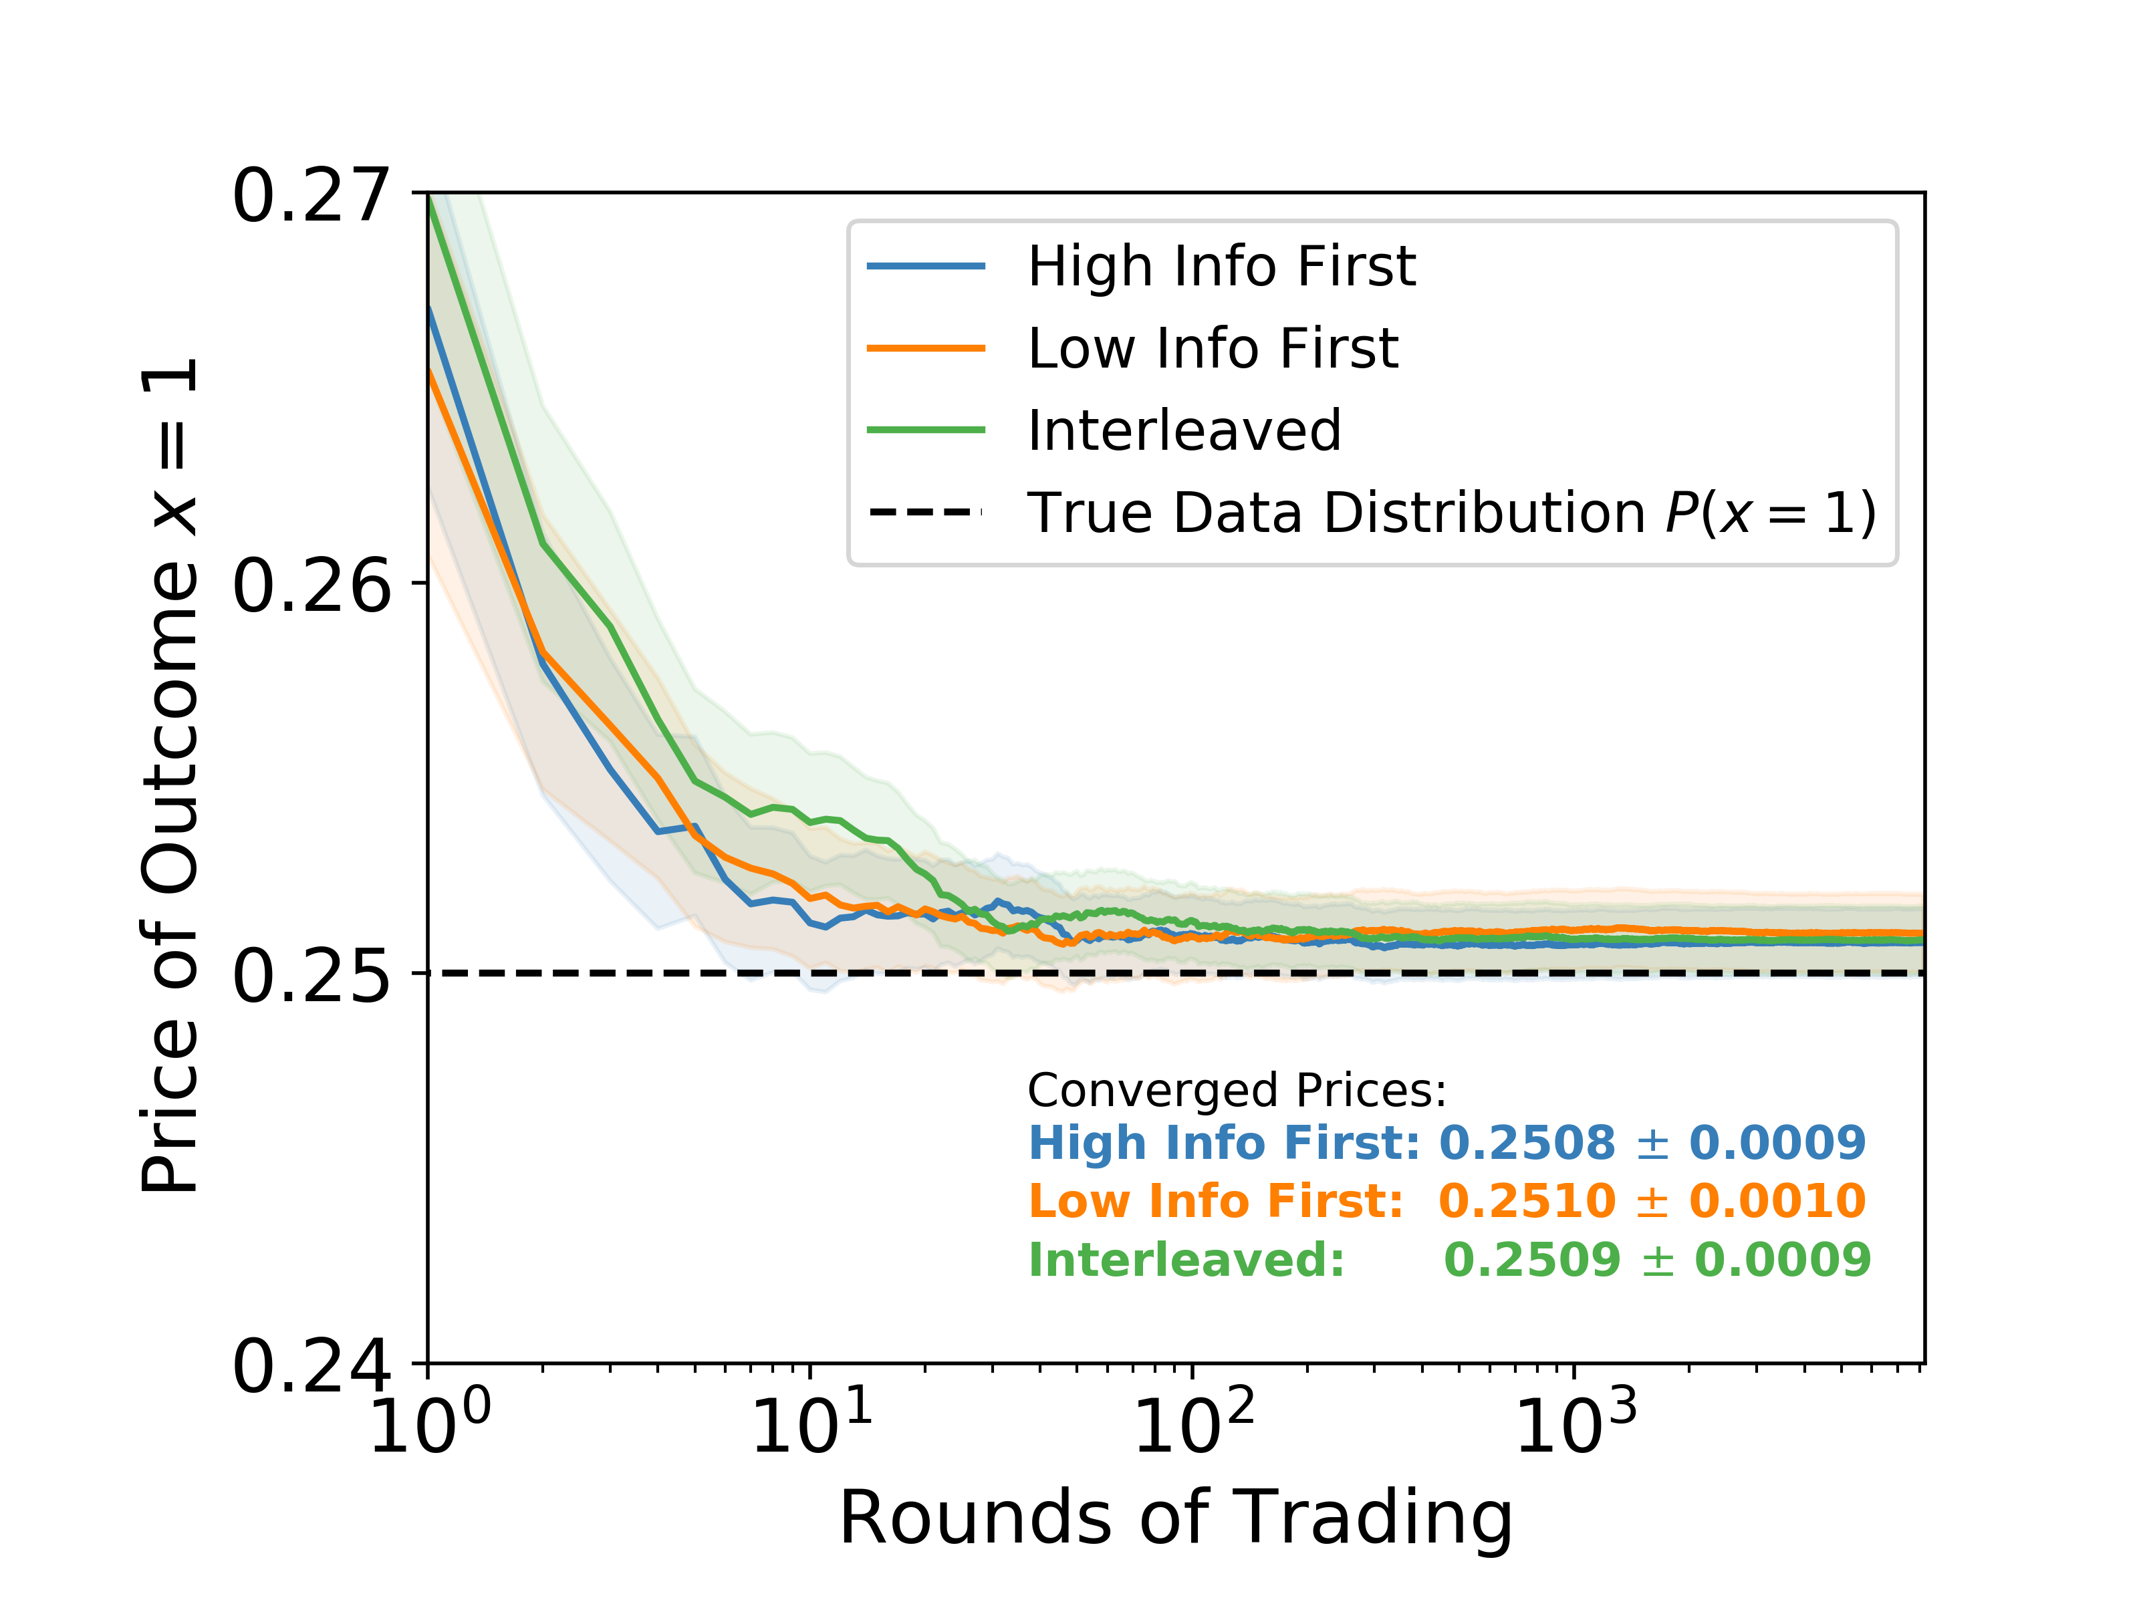
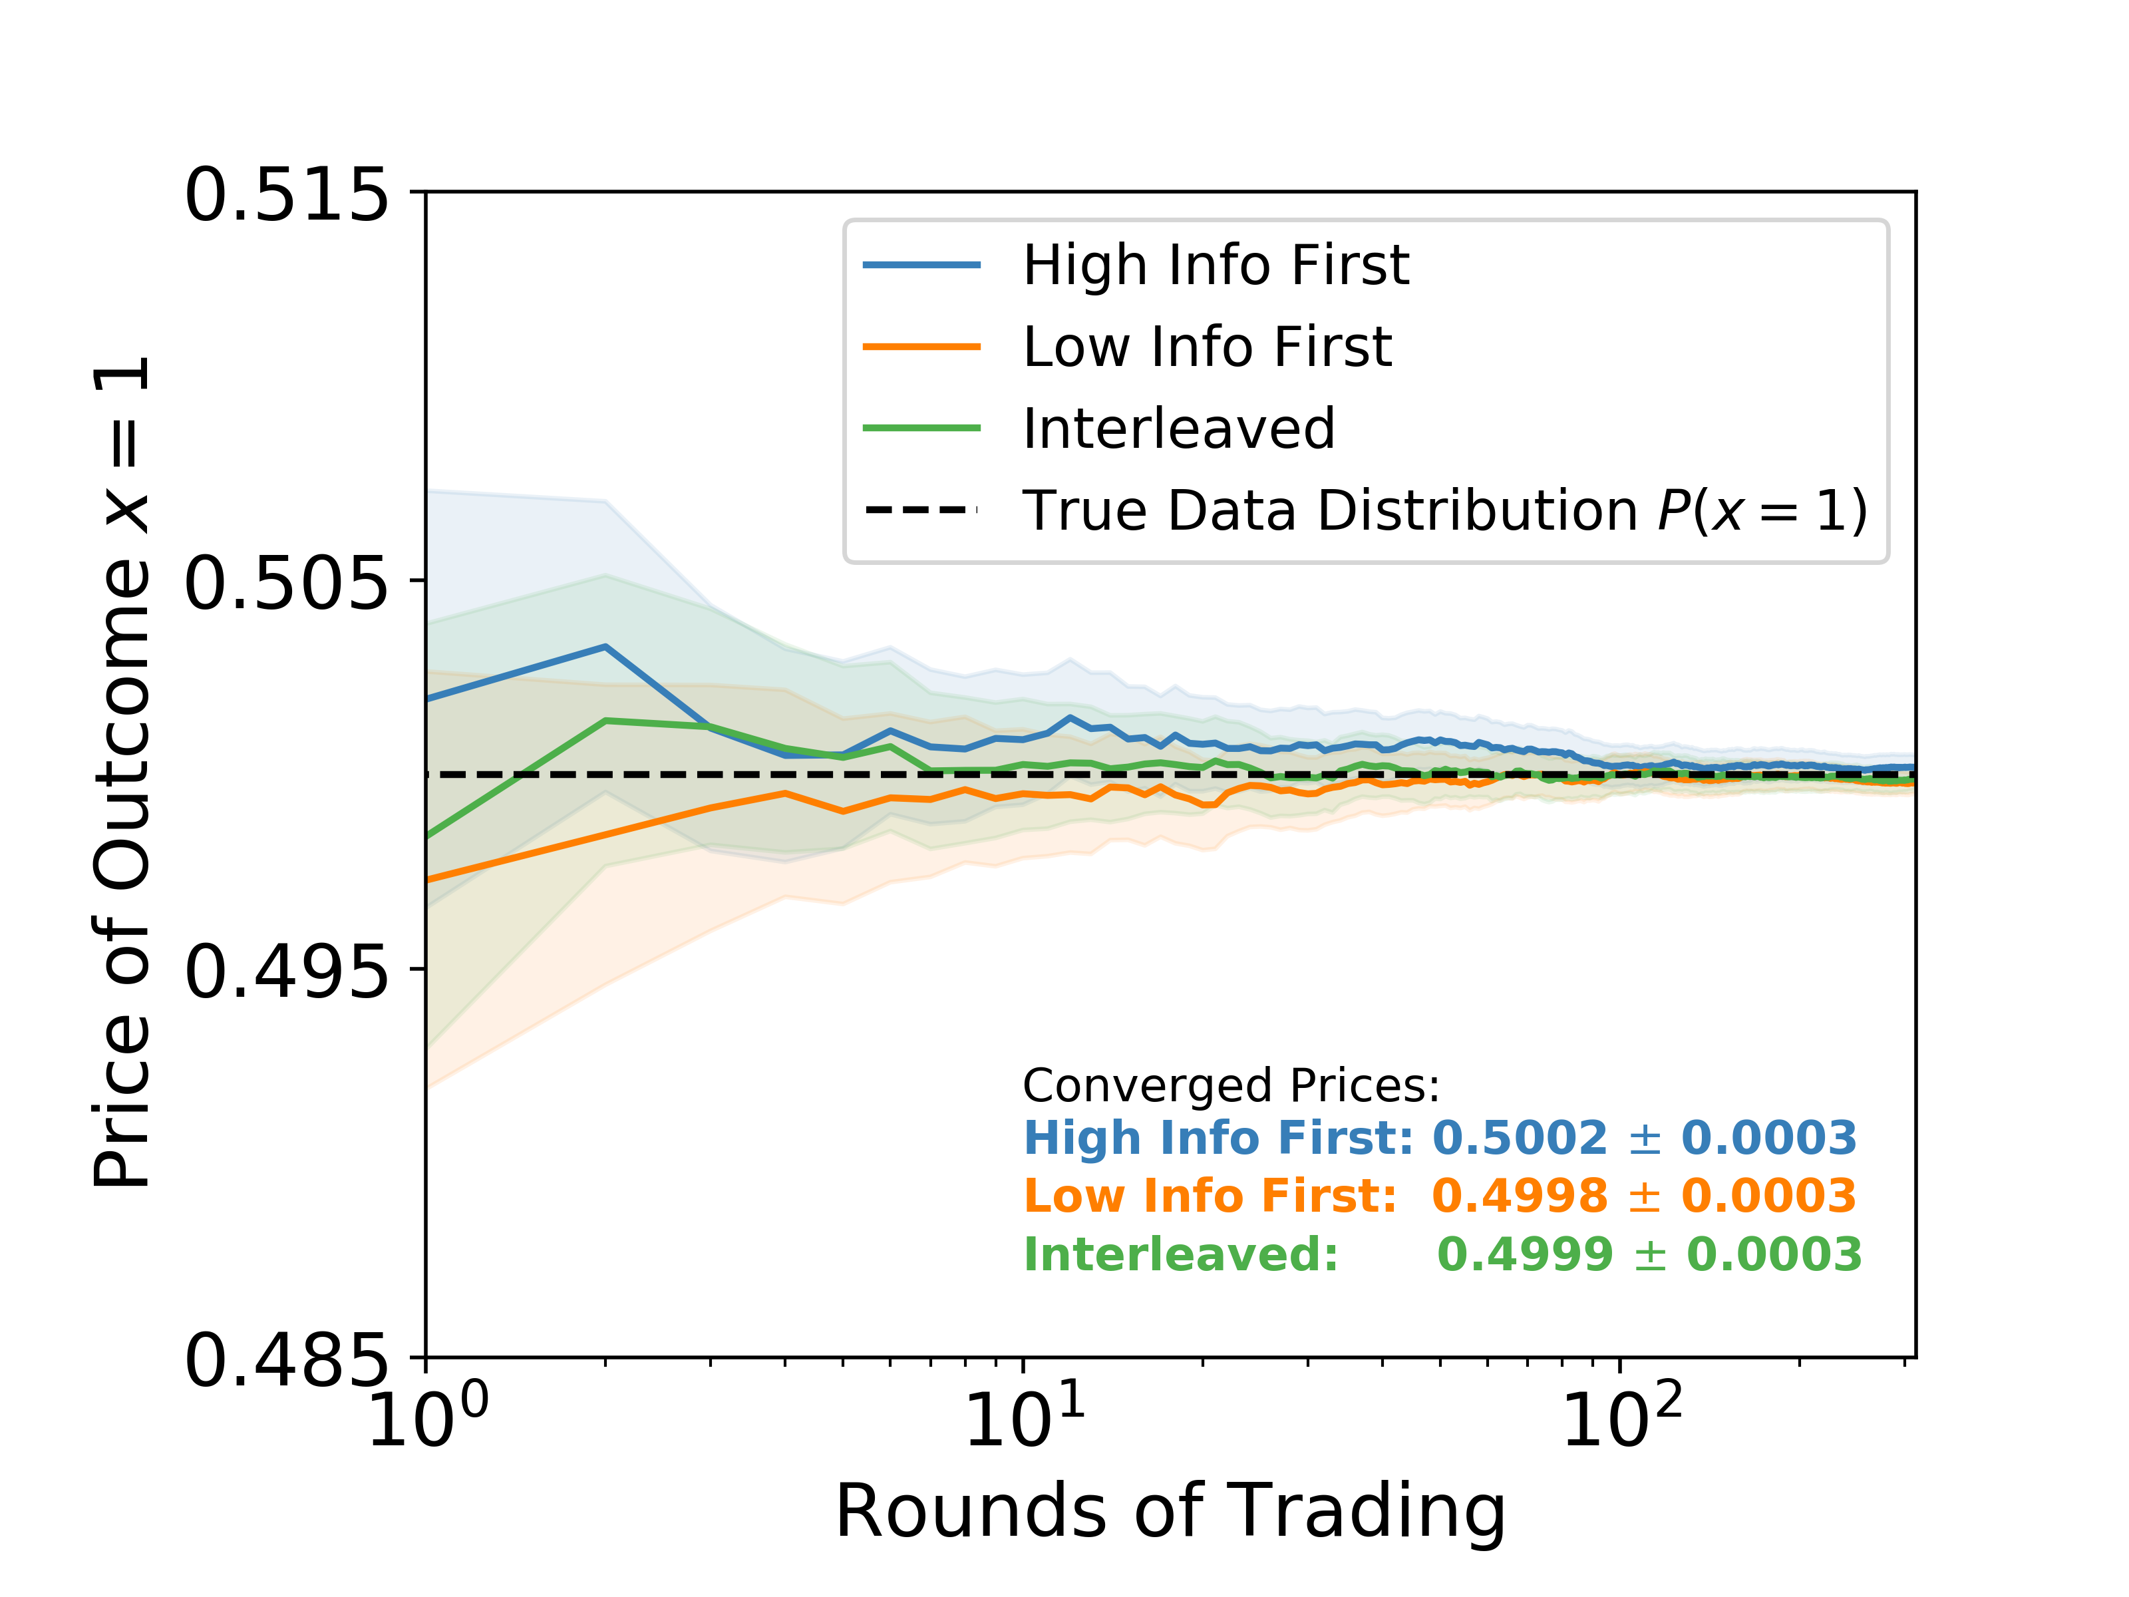
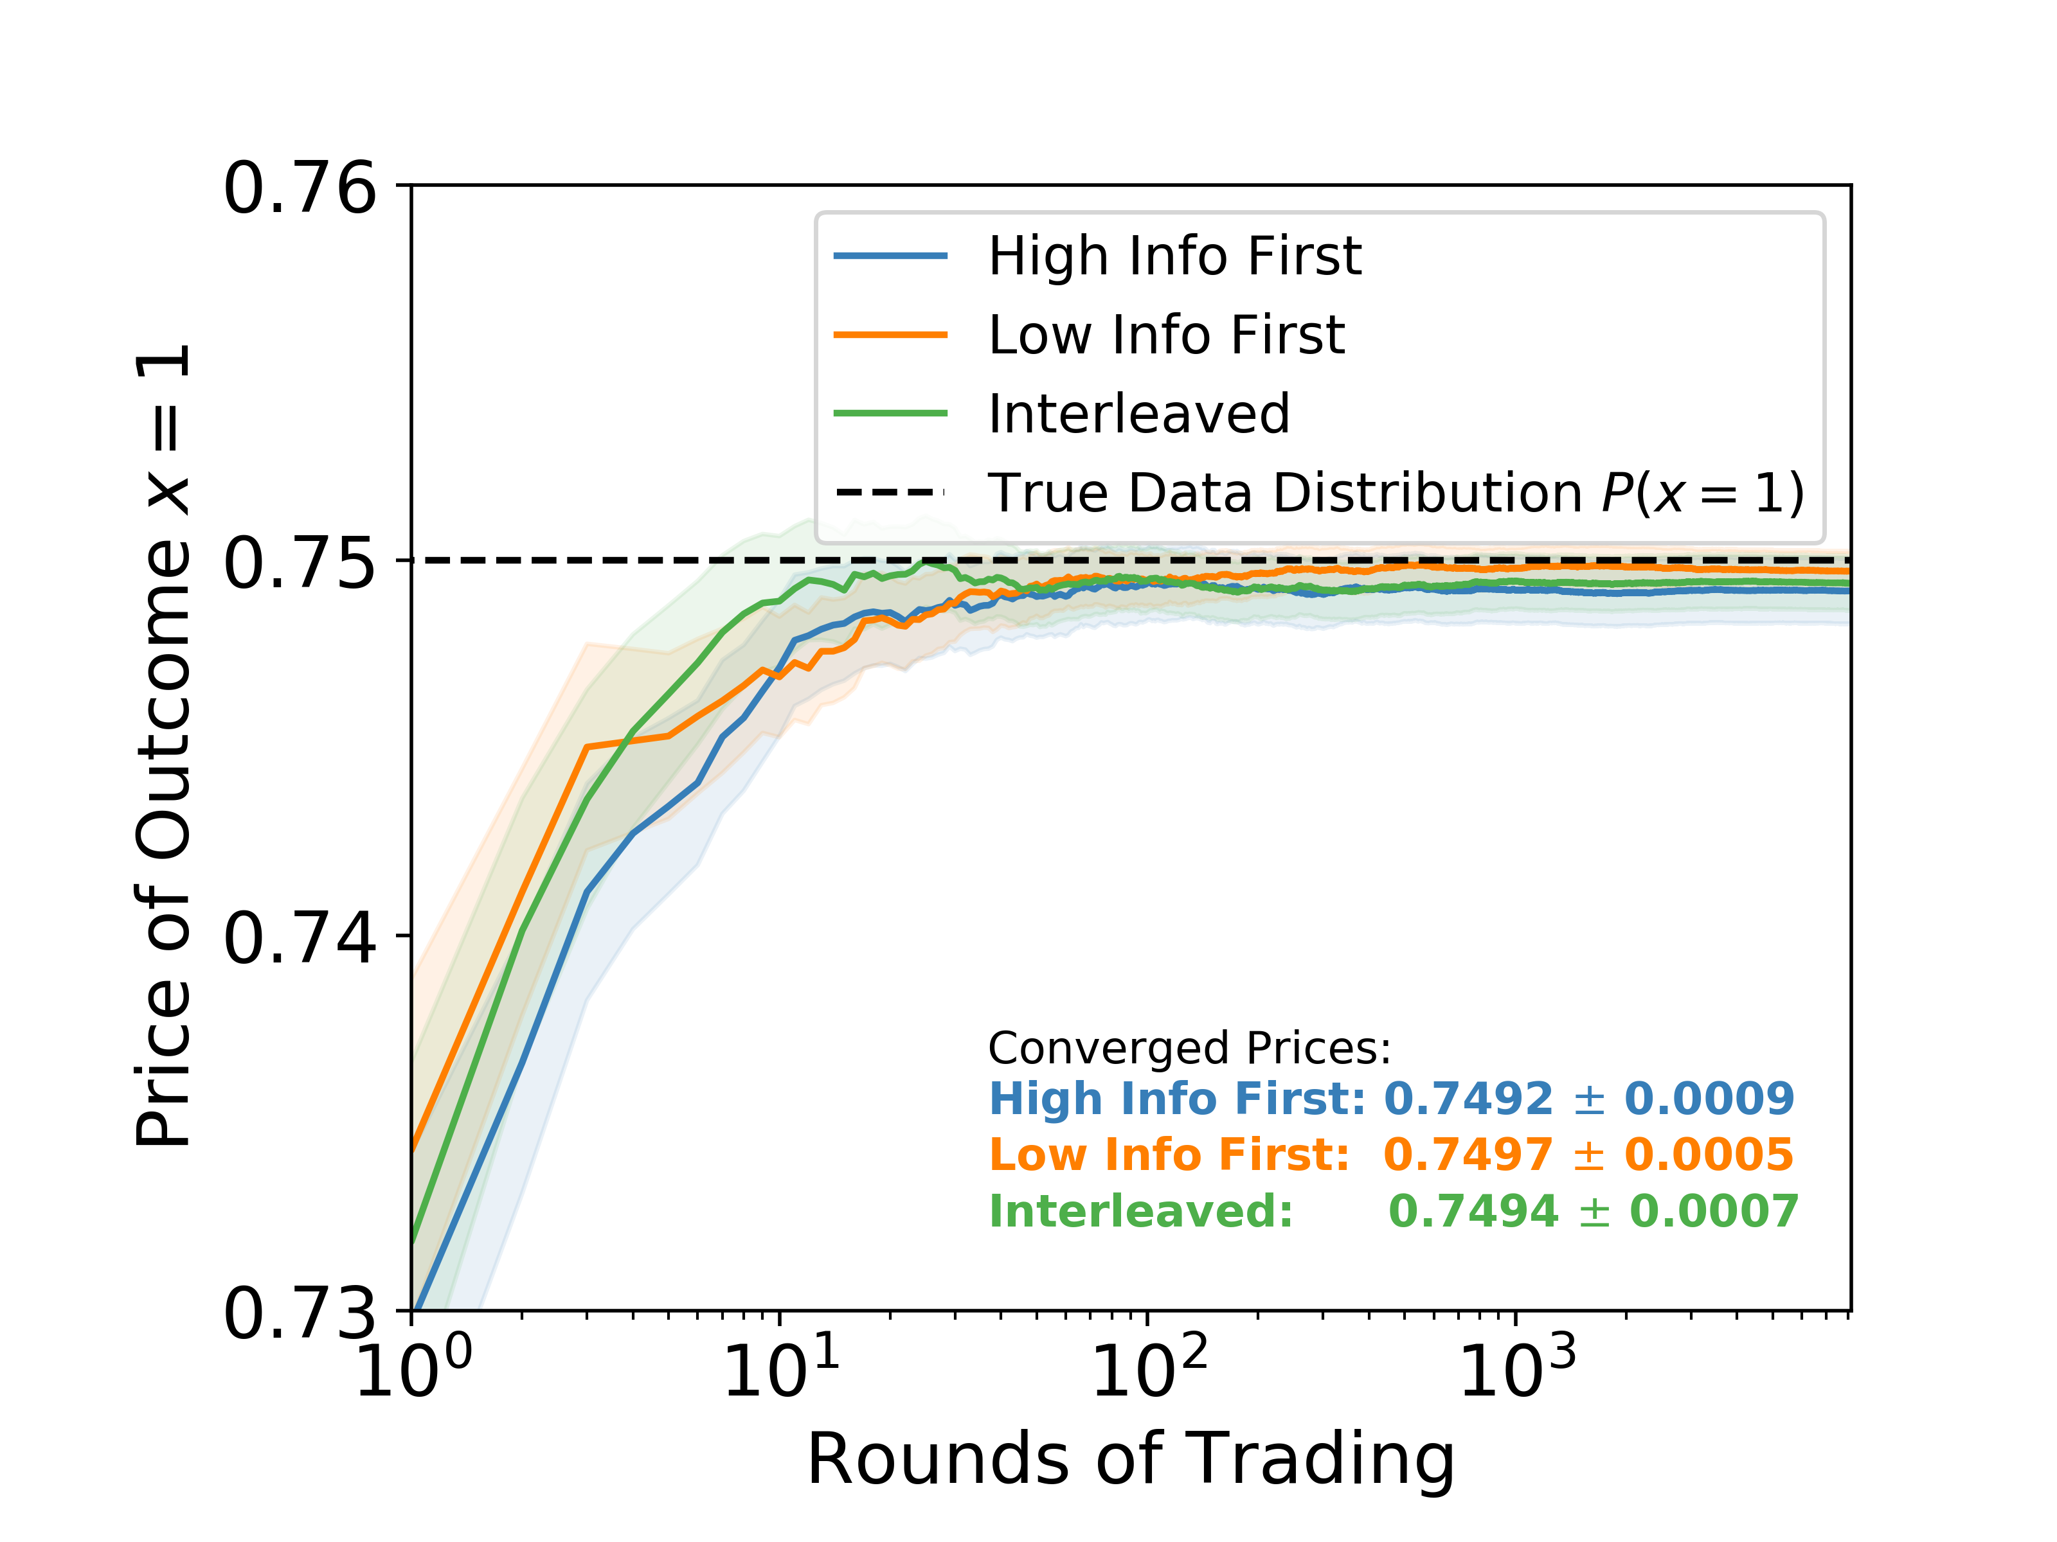
Experimental Results
Figure 1: Market prices averaged over 1000 simulations with a 95% confidence interval show variation in convergence speed and early-round compensation ($×{10}^{−2})$for traders with different levels of informativeness
Figure 2: Market prices averaged over 1000 simulations with a 95% confidence interval show no significant variation with different sequences of traders

Slide 7
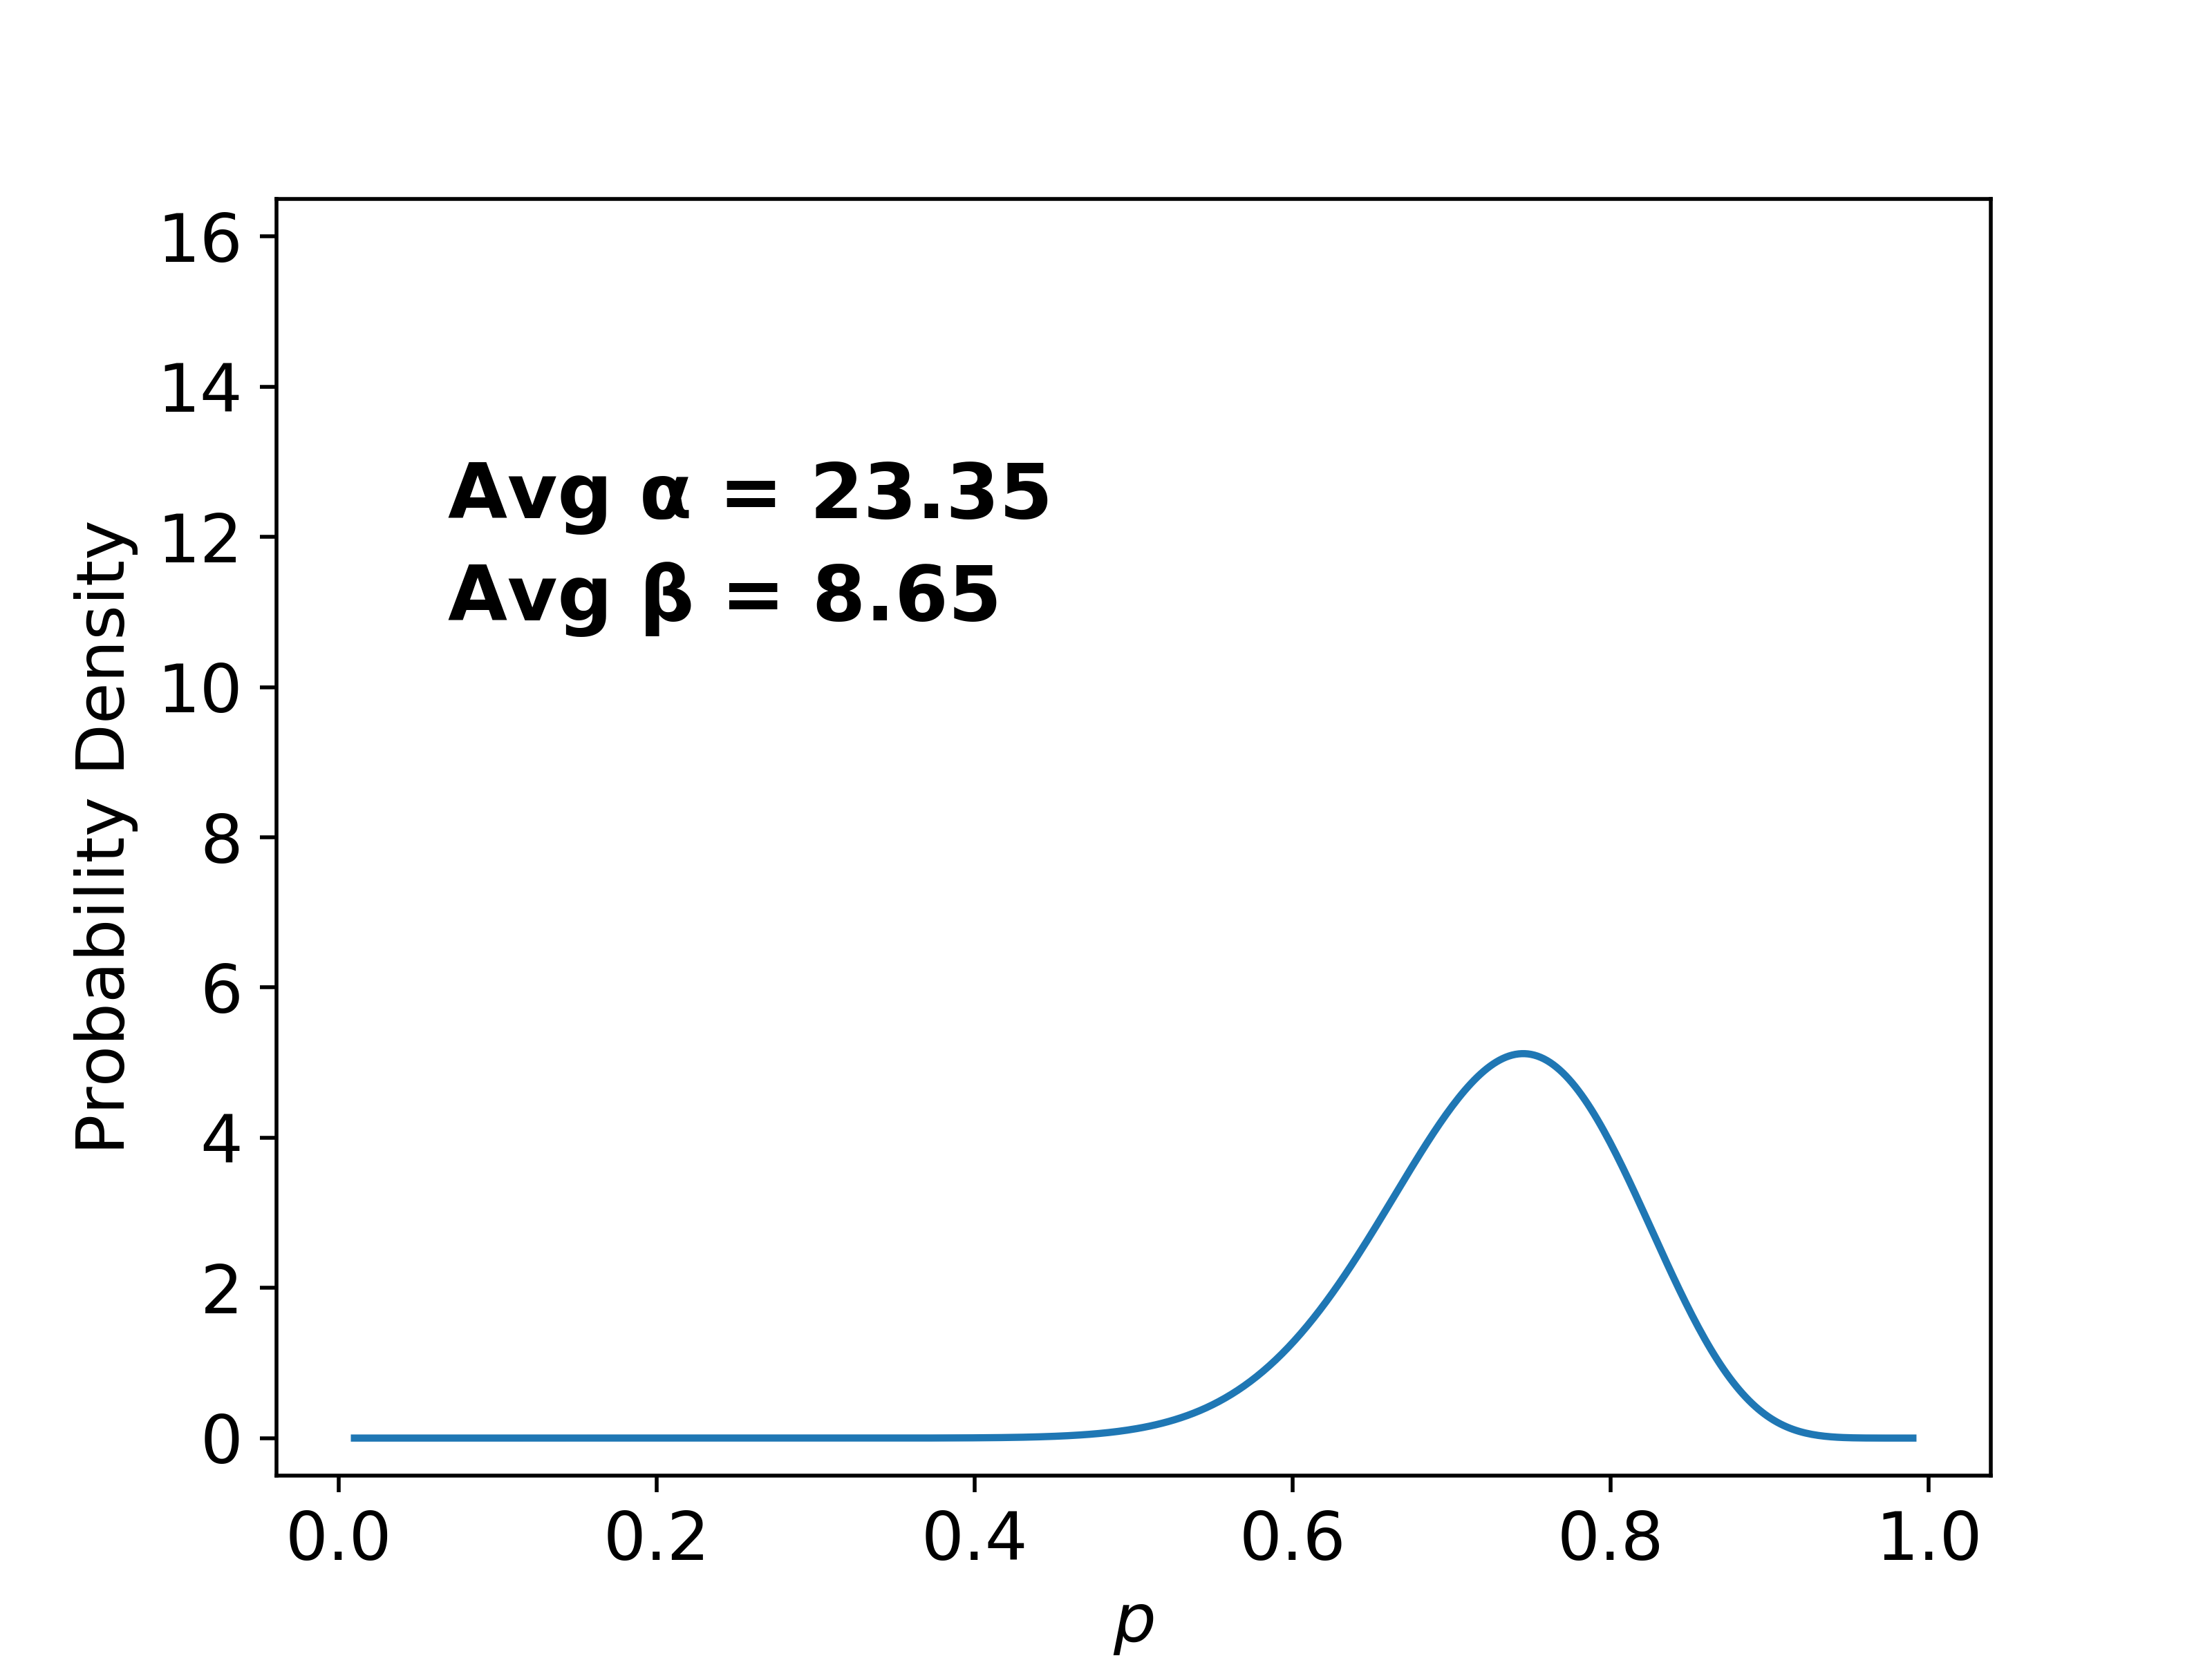
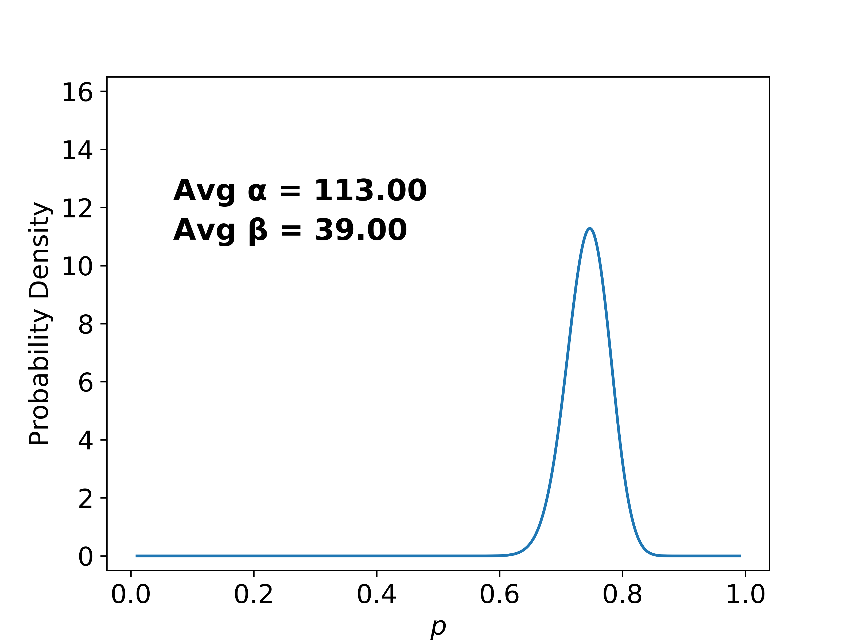
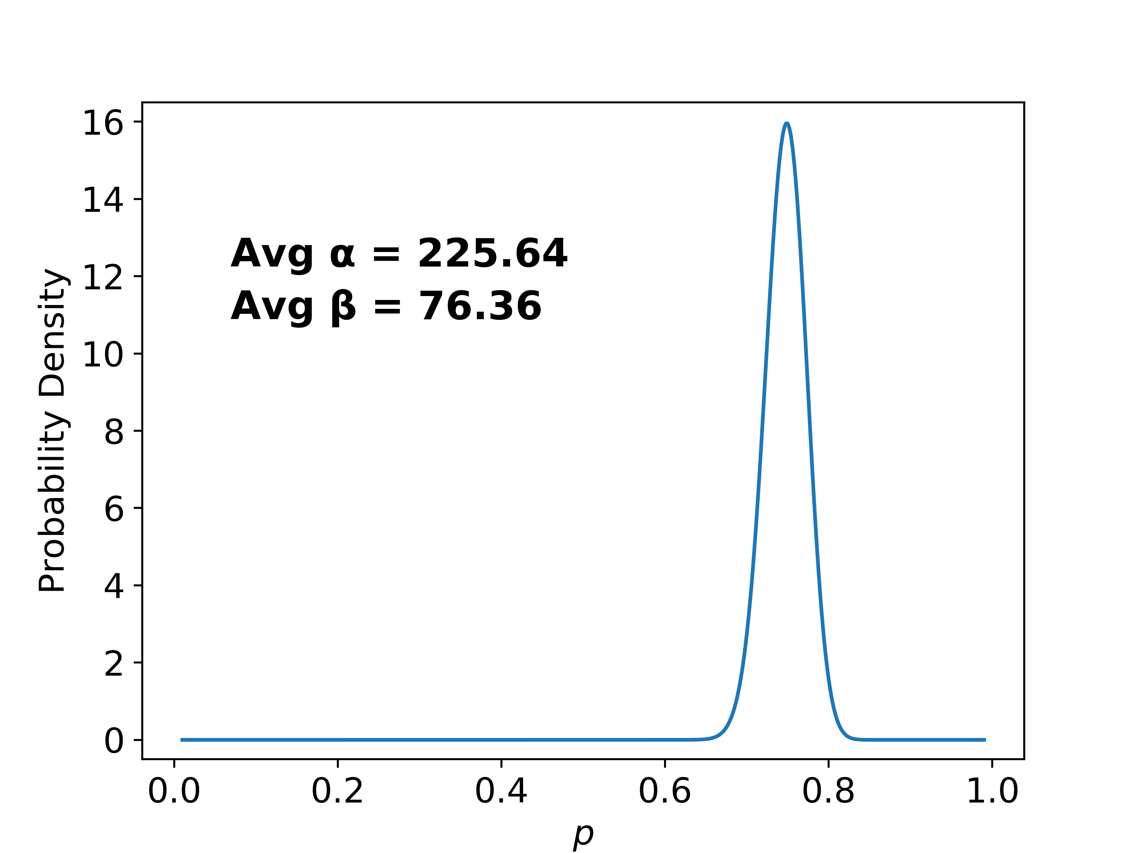
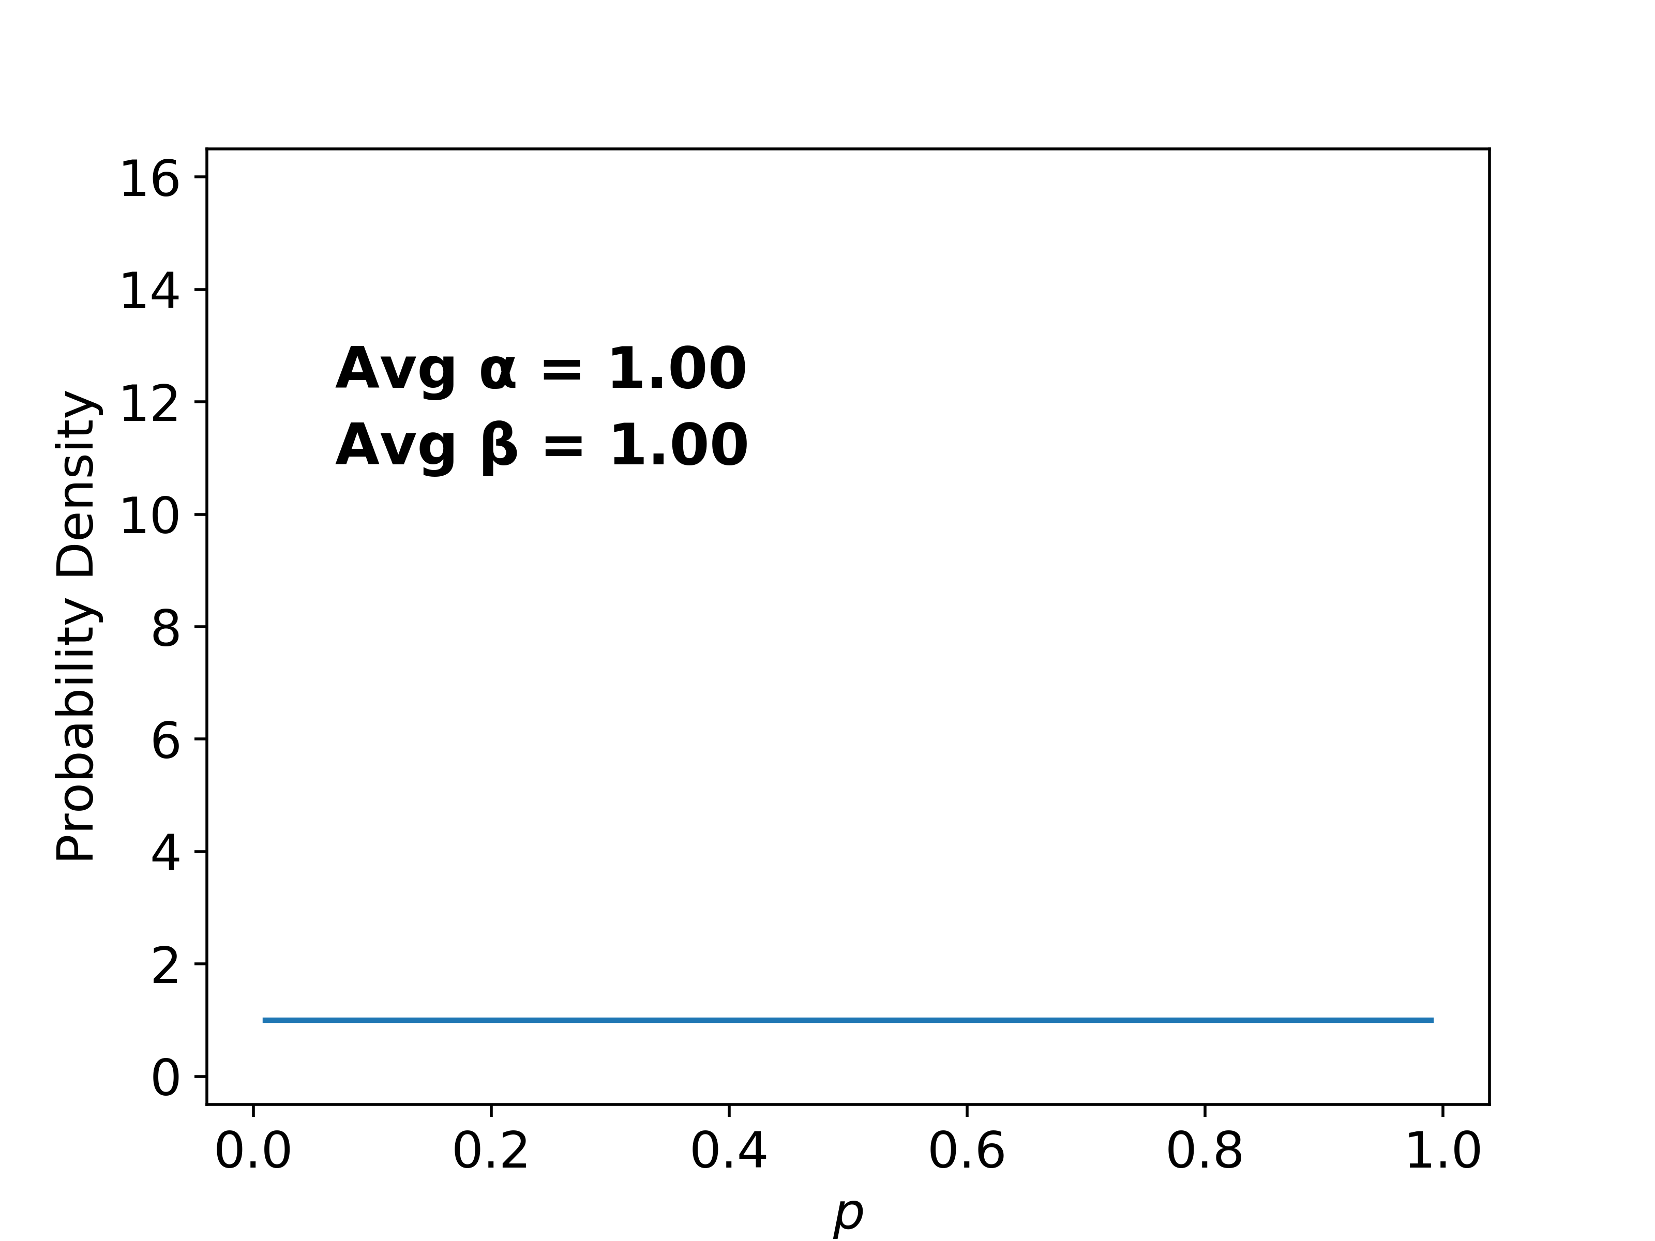

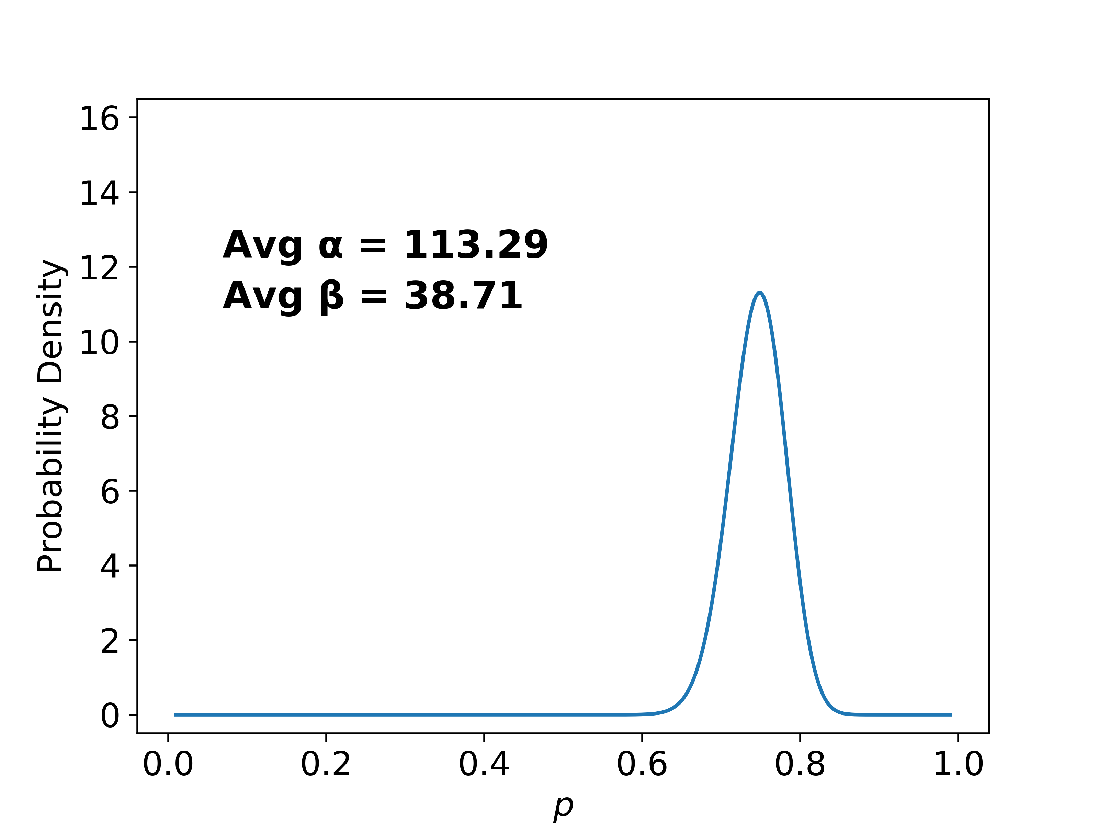
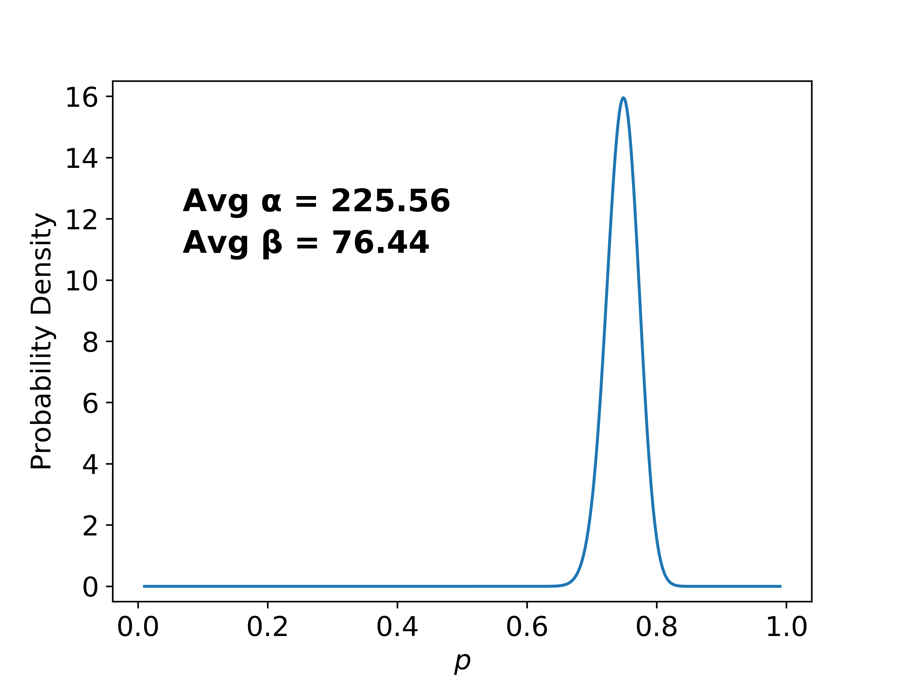
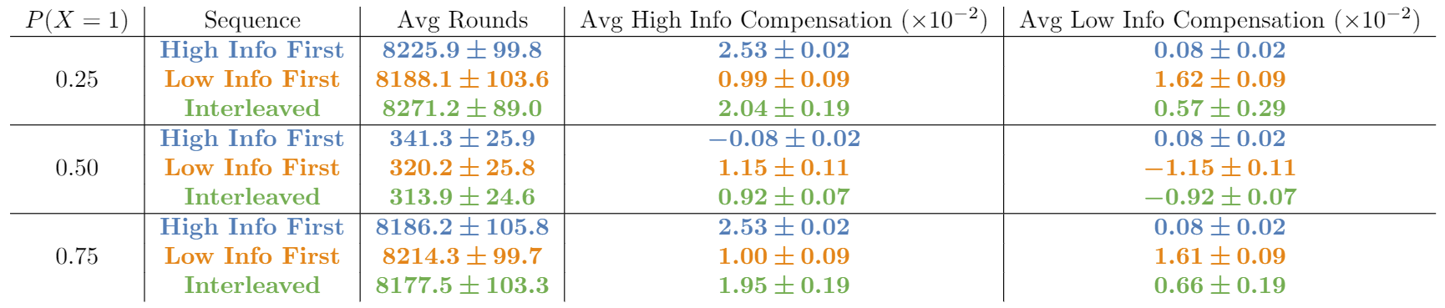
Experimental Results Cont.
After 1 Round
After 5 Rounds
After 10 Rounds
Market’s Initial Belief over p
High Info First
Uniform
Low Info First
Figure 3: With shape parameters averaged over 1000 instances of the market, the evolution of the beta posterior distribution P(p|x) over rounds of trading is practically unaffected by trader sequence
Table 1: Despite no significant impact on convergence time over 1000 market instances, sequence impacts the apportioning of compensation between high and low informativeness traders

Slide 8
Conclusions
Figure 1 confirms our intuition that market convergence is faster with only highly informative traders than with only low informativeness traders
Traders with the same overall informativeness induce the same price convergence characteristics regardless of the sequence in which they trade (Figs. 2-3)
The expected compensation of a trader depends not only on her informativeness but also strongly on the sequence as well as on prior parameters (Table 1)
Future work includes further experiments with other market designs and trader models as well as theoretical analysis to quantify the impact of the sequencing-informativeness interplay

Slide 9
Significant References
Jacob Abernethy, Sindhu Kutty, Sébastien Lahaie, and Rahul Sami. “Information Aggregation in Exponential Family Markets.” EC 2014
Martin Wainwright and Michael Jordan. “Graphical Models, Exponential Families, and Variational Inference.” Foundations and Trends in Machine Learning 2008
Robin Hanson. “Logarithmic Market Scoring Rules for Modular Combinatorial Information Aggregation.” Journal of Prediction Markets 2007

